Slide 1


How does program work ?
ZHENG Qinghua
2021. 12

Slide 2
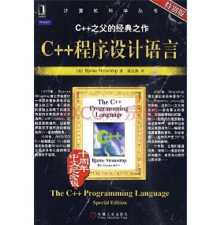
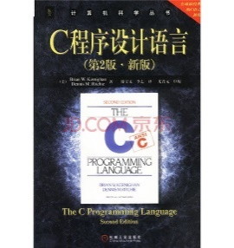
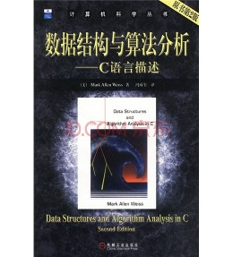
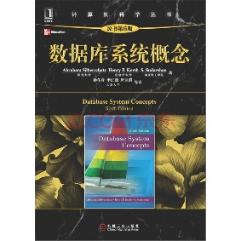
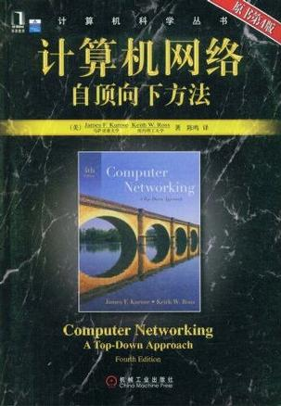
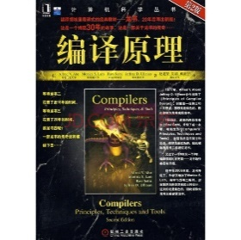
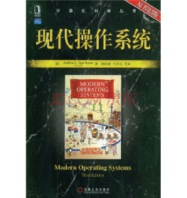
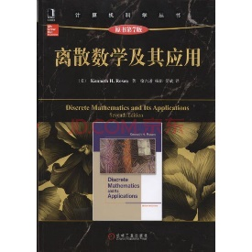
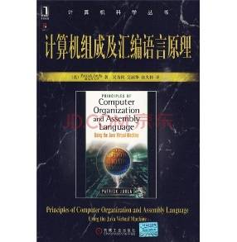
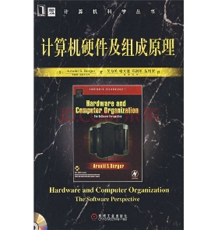
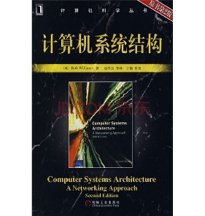
Before the Lecture
Related courses
Programming Language
Assembly Language
Compile
Operating Systems
Computer Architecture
And more...
Computer Networking
Database
Discrete Mathematics
Data Structure & Algorithm
...
...
Notes:
程序是怎么运行的？这个事情简单来说，就是从源代码，到计算机执行，这个过程中发生的事情。
但是要把这个说完整，说清楚，说尽量透彻，是好几门专业课程加到一起的事情，至少包括了：
程序设计语言
汇编语言
编译原理
操作系统
计算机系统结构
这几门课程。而且，有必要的话，还有离散数学，算法与数据结构、计算机网络、数据库等课程对上面这些课程的关键内容的补充，或者特殊的程序过程的深入讲解。
光是看这些课程名字还有旁边这些经典教材封面，大家就应该能多少了解这个问题的涉及面了吧?这些课程从各个侧面涵盖了影响程序运行的多个因素，每一个课程都有大量的研究内容，同时也代表了计算机研究领域的一个研究方向，每个方向深入下去都有可能走到计算机研究的前沿。
不过本课程只是导论，显然不可能涵盖这么多内容。
所以接下来，我们将从计算机程序这个事情开始说起，介绍围绕计算机程序相关的问题。

Slide 3

Outline
How Program works
Computer Program
Programming Language
Operating System

Slide 4

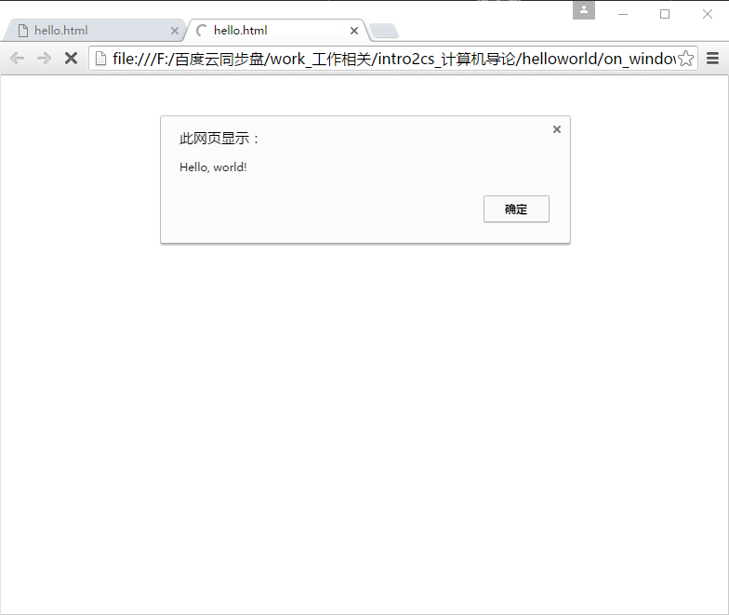
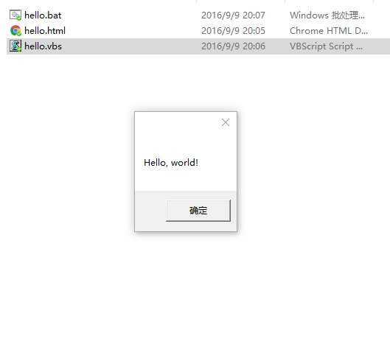
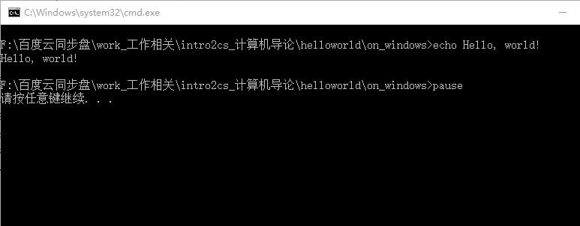
Computer program – Hello, world!
Run simplest “Hello, world” program on Windows environment.
in JavaScript
<script>
alert("Hello, world!");
</script>
in VBScript
MsgBox "Hello, world!"
in Windows Shell
echo Hello, world!
pause
Hello, world on web browser
Hello, world on Windows desktop
Hello, world on Windows Shell
Notes:
4
hello, world简直就是所有计算机程序入门的必经之路
初学一门语言？先从打印hello, world开始。
程序运行不正确了？把关键步骤替换成打印hello, world看看能不能正常走完流程。
路过卖电脑的苏宁国美沃尔玛，随手打开记事本写一个hello, world，开机自动启动，是不是很拉风？
现在写一个程序真的非常方便，不用安装IDE环境，立刻可以开始。在任意的Windows系统上，打开记事本，写这样一段：
<script>alert('Hello,world!');</script>
保存为hello.html，用浏览器打开，这样我们就用HTML语言和JavaScript语言写一个不那么规范但是可用基本程序。
或者这样：
MsgBox "Hello, world!"
保存为hello.vbs，双击，就用VBS语言写了一个程序。
或者这样：
echo Hello,world!
pause
保存为hello.bat，双击，就用Windows Shell写了一个基本的批处理程序
是不是很方便？这么快我们就用3种语言搞出来3个程序！
不过，最重要的是，这3个例子里，都包含了程序运行的重要因素。
第一，我们要用编程语言来写hello, world
第二，我们需要有一个运行环境。
最后，要将写好的程序转换为运行环境所要求的形式。
从这3个因素，我们就有了计算机程序的定义了。

Slide 5




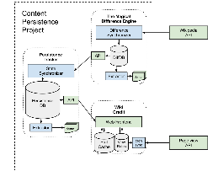
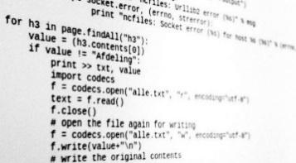

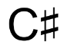




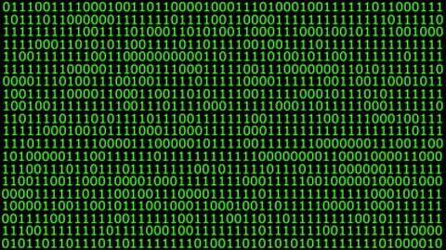

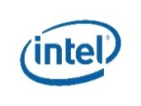

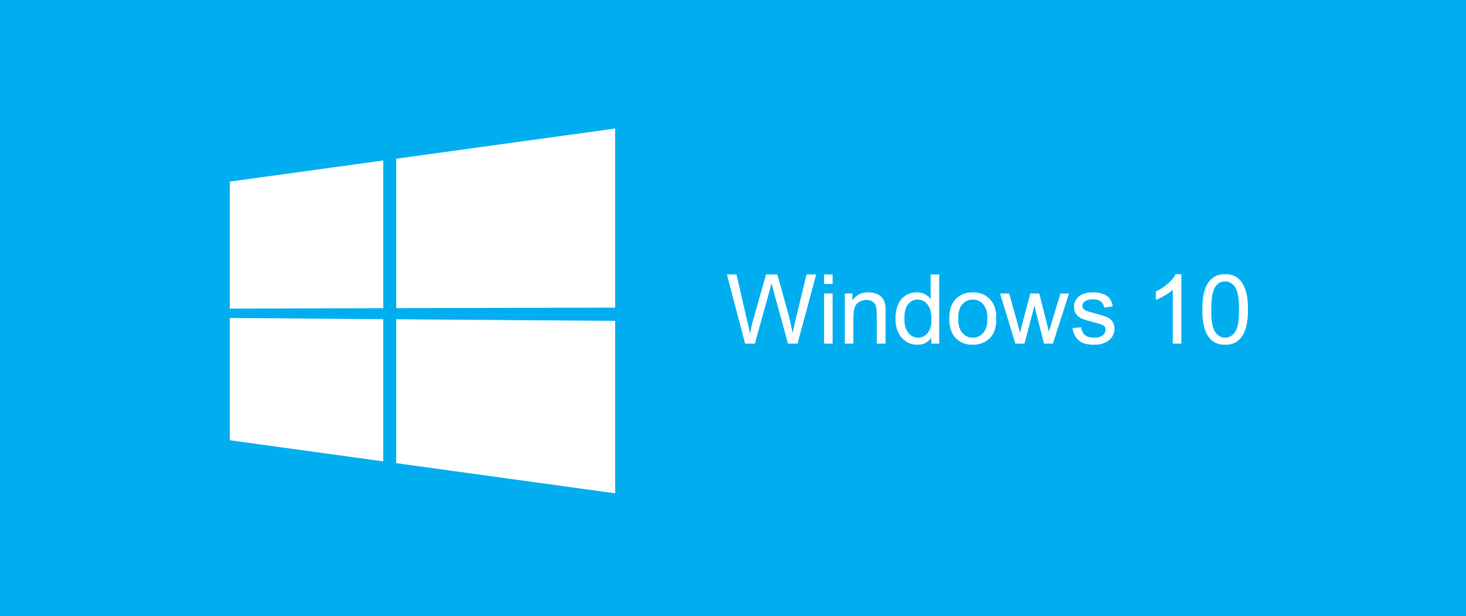




Computer program - Definition
A computer program is a collection of instructions that performs a specific task when executed by a computer^{[1]}.
Collection Of Instructions
+
Programming
Programming Language
Design
Source Code
Compile
Translate
Source Code
Native Code / Machine Code
Computer
+
Hardware
Operating System
[1] https://en.wikipedia.org/wiki/Computer_program
Notes:
5
计算机程序是什么？参考维基百科和教科书上的定义来说，计算机程序就是能够在计算机上执行的特定任务的指令集合，所谓特定任务，就是开发人员把这个程序搞出来的目的，想要解决什么问题？比如在屏幕上显示hello,world，存点数据，抓些网页，抢个火车票，玩个游戏，管理资源，分析数据，只要是一个需求，都可能是我们写程序要解决的问题或者说任务。那么为了解决这个任务，用程序怎么做？
三个事情，计算机，执行，指令集合。
首先，指令集合是什么呢，从目标来说就是完成特定任务需要的操作步骤和数据，就像做菜的菜谱一样。这个将会涉及到编程语言与程序设计的问题，将这两者结合，通过编程，我们就有了指令集和，通常也就是源代码了。
然后，当然是给计算机用，人其实也能用就是太累了，如果人都像是《三体》里描述的三体人那种结构，给人用其实也能行。但是由于计算机自身的体系架构和组成也有很大差异，所以同样的任务、同样的指令集合，在不同体系的计算机上执行也会有差异，这些内容会在计算机组成原理、编译原理之类的课程中详细说明。另外，即便是同样的硬件，操作系统以及运行环境的不同也会直接影响程序的运行。
最后，为了将源代码变为计算机能用的东西，需要一个翻译的过程，得到的本地代码或者说机器代码最后就可以在计算机上执行了。

Slide 6
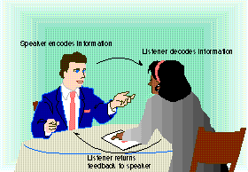
1
Programming language
PART
PART
PART
Communication cycle
One complete unit of communication
An idea to be sent
An encoder
A sender
A medium
A receiver
A decoder
A response
Speaker encodes information
Listener decodes information
Listener returns
feedback to speaker

Slide 7
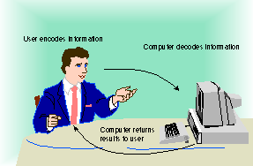
1
Programming language
PART
PART
PART
Substituting a computer for one of the people in the communication process
Process is basically the same
Response may be symbols on the monitor
Programming languages bridge the gap between human thought processes and computer binary circuit
User encodes information
Computer decodes
information
Computer
returns results to user

Slide 8
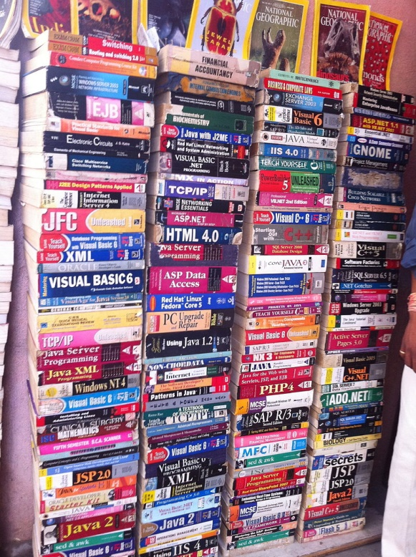
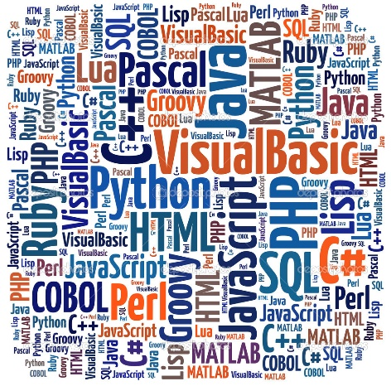
Programming language
Programming Language: A formal computer language or constructed language designed to communicate instructions to a machine, particularly a computer^{[1]}.
Machine readable
Machine language
Human readable
Assembly language,
FORTRAN, Pascal,
C / C++, Java, PHP,
Python, Ruby, Perl,
MATLAB, Wolfram,
Scala, GO, Swift, etc
Compile
A picture of books that teaching programming languages and a word cloud of programming language names. There are thousands of programming languages are invented in the history.
[1] https://en.wikipedia.org/wiki/Programming_language
Notes:
8
关于指令集合，有2个方面的内容是需要说明的
首先也是最基本的，就是编程语言.
编程语言有非常多，一百种没有任何问题，也有人说有上千种的。
首先，最基本的，可以分成两类：
一类是面向机器，或者说计算机的，称为机器语言或者本地代码，计算机或者准确一些CPU能用的指令，也就是上面0101那些指令集合，机器只认这个。
另一类是面向人类的，统称都是编程语言了，显然0101这个对人来说太难理解了，我反正看不懂，所以就要有面向人类的编程语言嘛。
从面向人类的语言到面向机器的语言中间，有一个翻译的过程，也就是编译了，这个我们在后边再说。

Slide 9




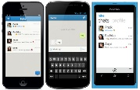
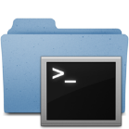

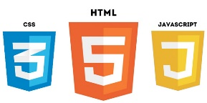


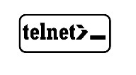
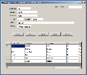
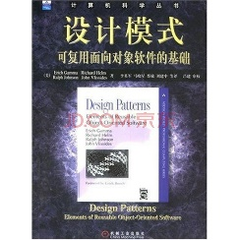
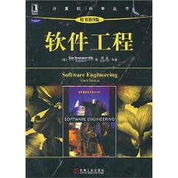




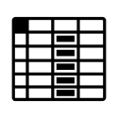
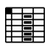






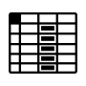
Design
Design of computer program including 2 levels:
Architecture
weibo.com
Data Structure & Algorithm
Client
(Browser/
Mobile)
Browser
Mobile
Management
Server
Dynamic
Static
Business 1
Content Delivery Network
Business 2
Business 3
Service-Oriented Architecture
Binary
Text
Data
Persistent
Cached
Related Books
Structured
Non-Structured
Semi-Structured
Notes:
9
程序设计也很复杂，具体的内容在我看来涉及到2个方面的内容，第一是架构设计、第二是数据结构与算法设计，这2个方面都有非常多的内容，
第一部分架构的很多内容都是软件工程方面的.
比如说我们要做个类似微博的网站，那好，最基本的这个网站先分3层吧，前端，后端，数据持久化。
前端再分Web、移动、管理。后端要支持这些肯定动静分离、动态内容再用面向服务的架构按照业务逻辑分一下。数据持久化基本的也有个结构化、半结构、非结构，同时划分为持久化和缓存两个部分。
这当然不够具体，那么再深入一层可以继续分，Web用哪个html和js的框架？移动端iOS和Android的支持各用哪个还是用统一的？管理端要shell的还是web的？后端静态化这边用cdn还是本地静态服务器?面向服务架构也要按照业务逻辑继续细分，比如用户服务、帖服务、好友服务、管理服务等等；数据层各类是选一个还是多个？
所有这些在设计的时候，同时还要考虑扩展性，你自己用的，你们班30来人里用的，学校几千人用的，乃至上万，十万、百万、千万、亿用户的，这之间的差别非常大。那么我们设计的架构支持的扩展性到什么级别？
比如网友经常吐槽的12306卖火车票的那个网站，其实难度非常大的，平时没什么人用的话，找个一队实习生学学JSP做上1个月就ok了，但是春运来了，分分钟内down掉。
不过，实际上，到目前为止，这个架构设计还没有和业务“微博”这个事情关联起来。也就是说，这个架构是个空泛的说明，用来做微博可以，用来做微信也可以，用来做学校的选课系统、主页、校园一卡通系统都是可以的。只要对这个架构中的每一个子模块不断的深入下去，就会涉及到具体的业务内容，如何设计各个子模块已经平衡各个模块之间的关系，是将来软件工程、系统架构、设计模式等课程中要学习的东西，并且，光看书听课可能还是学不会的，必须动手实践，还要随着你们的具体工作而不断积累经验才能掌握。这里我们就不再具体展开了，在你们的本科乃至硕士博士学习中还要不断的深入。

Slide 10
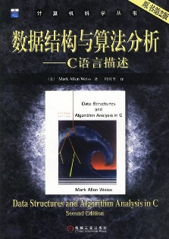
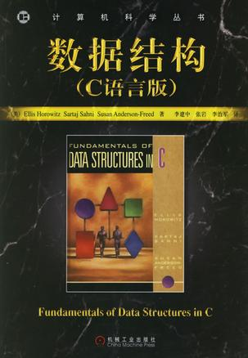
Design
Design of computer program including 2 levels:
Architecture
A data structure is a particular way of organizing and sorting data in a computer so that it can be used efficiently
Data Structure & Algorithm
There are two types of data structure
Linear Data Structure
A data structure is said to be linear if its elements form a sequence, or in other words a linear list
Array
Stack
Queue
Linked List
Non- Linear Data Structure
A non-linear structure is mainly used to represent data containing a hierarchical relationship between elements.
Tree
Graph
Related Books
Notes:
10
另外数据结构设计和算法设计的内容也是非常庞大的，相关内容会在本课程的其他章节中说明。

Slide 11
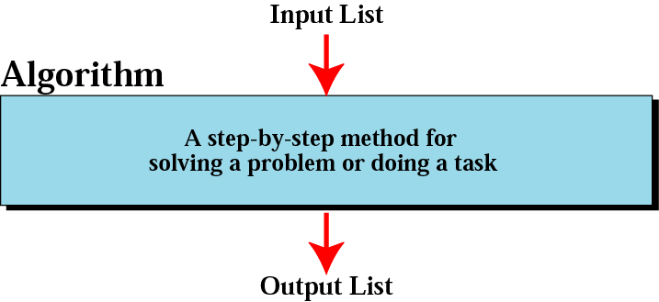
Design
Design of computer program including 2 levels:
Architecture
Algorithm
Data Structure & Algorithm
It can be defined as a collection of unambiguous executable instructions, whose step by step execution leads to a predefined goal, within a finite number of steps.
Goal: Desired input/output relationship.
Related Books
Notes:
11
另外数据结构设计和算法设计的内容也是非常庞大的，相关内容会在本课程的其他章节中说明。

Slide 12
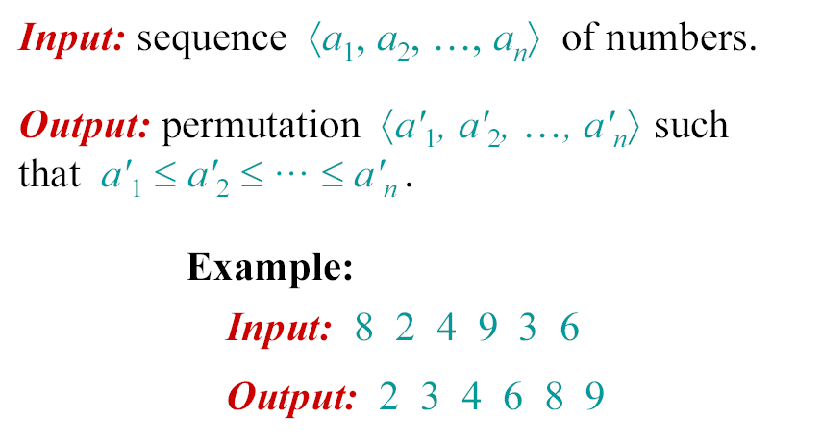
1
Design: an example
PART
PART
PART
Example of Insert Sort

Slide 13
1
Design: an example
PART
PART
PART
Array
An array is a data structure consisting of a collection of elements (values or variables), each identified by at least one array index or key
An array is stored so that the position of each element can be computed from its index tuple by a mathematical formula.
点击添加文本
点击添加文本
点击添加文本
Array:
1 | 2 | 7 | 9 | 8 | 6 | 5 | 3
0 | 1 | 2 | 3 | 4 | 5 | 6 | 7
点击添加文本
Array index

Slide 14
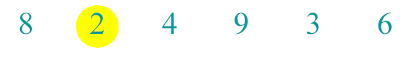
1
Design: an example
PART
PART
PART
Example of Insert Sort

Slide 15
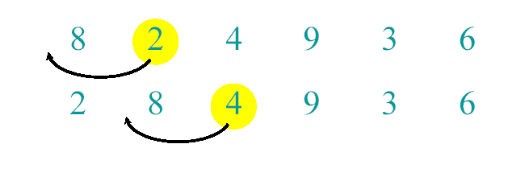
1
Design: an example
PART
PART
PART
Example of Insert Sort

Slide 16
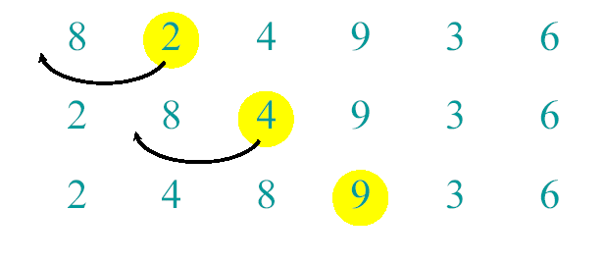
1
Design: an example
PART
PART
PART
Example of Insert Sort

Slide 17
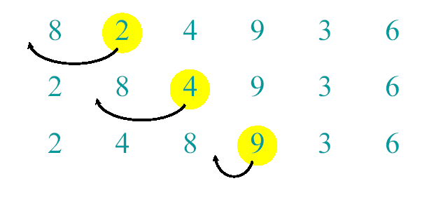
1
Design: an example
PART
PART
PART
Example of Insert Sort

Slide 18
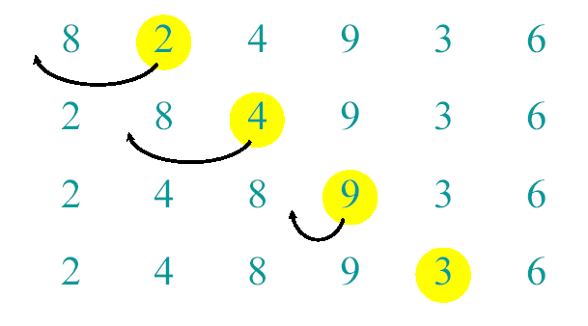
1
Design: an example
PART
PART
PART
Example of Insert Sort

Slide 19
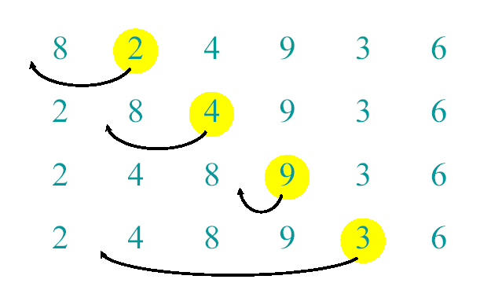
1
Design: an example
PART
PART
PART
Example of Insert Sort

Slide 20
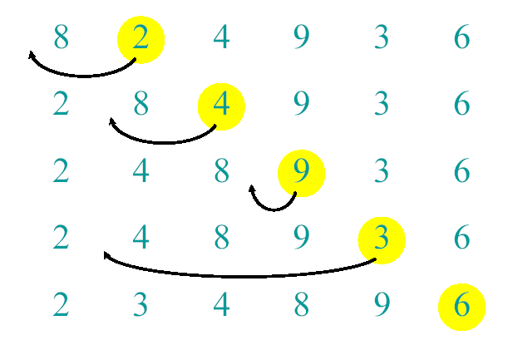
1
Design: an example
PART
PART
PART
Example of Insert Sort

Slide 21
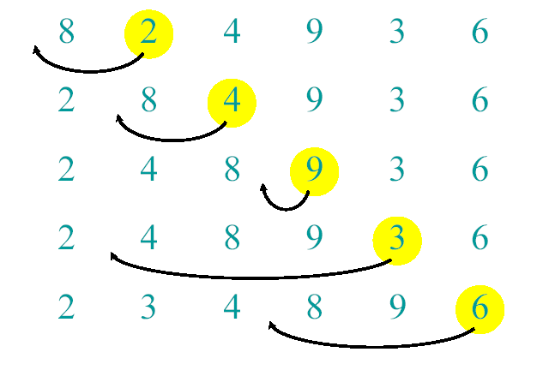
1
Design: an example
PART
PART
PART
Example of Insert Sort

Slide 22
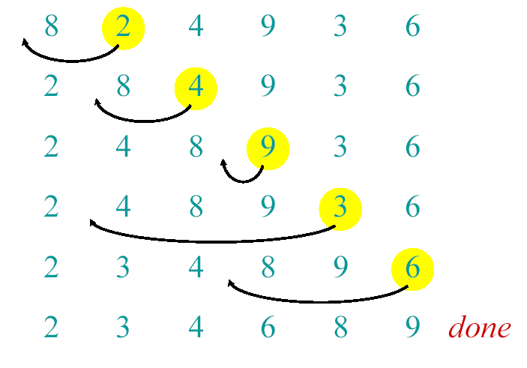
1
Design: an example
PART
PART
PART
Example of Insert Sort

Slide 23

1
Design: an example
PART
PART
PART
Example of Insert Sort
A pseudocode for insertion sort ( INSERTION SORT ).
INSERTION-SORT(A)
1 for j ← 2 to length [A]
2 do key ← A[ j]
3 ∇ Insert A[j] into the sortted sequence A[1,..., j-1].
4 i ← j – 1
5 while i > 0 and A[i] > key
6 do A[i+1] ← A[i]
7 i ← i – 1
8 A[i +1] ← key

Slide 24
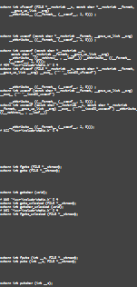
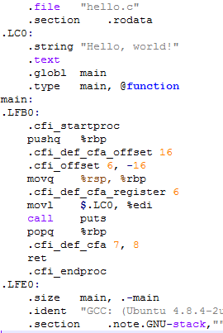
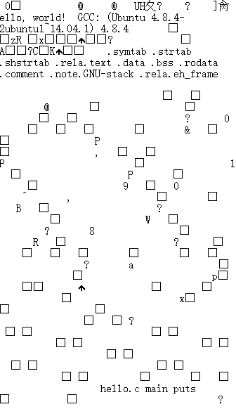

Compile - Compilation
Translate source code from a human-readable language into either machine code or object code.
Source Code
Machine Code
preprocessor
(cpp)
compiler
(ccl)
assembler
(as)
linker
(ld)
hello.c
hello (executable)
hello.i
hello.s
hello.o
#include <stdio.h>
int main()
{
printf("Hello, world!\n");
}
C code
assembly code
binary code
preprocessed code
binary code
Notes:
24
用编程语言写好了程序，下来就是运行的事情了，编程语言不一样，这个过程也不太一样，但基本而言，都包括以下几个步骤：
预处理：gcc -E hello.c -o hello.i
编译：源代码根据系统环境变为本地代码。
汇编：
链接：本地代码装配系统环境提供的链接库，变成可执行文件
然后，我们就可以执行了，可执行文件会调用系统环境，执行功能：
以hello.c那个程序来说，只要执行
gcc hello.c -o hello
gcc就会完成编译、链接，然后就可以执行了
./hello
完整的过程其实比较复杂，gcc为我们省略了很多烦人的内容，使用Windows下的VS系列IDE或者其他集成编程环境也是一样，只要点一下build系统就会为你代劳了。
程序基本上就是这么运行的了，不过各个编程语言都有一些相对独特的地方，这里说的编译、链接在编译原理和汇编语言里会讲到。
除了是解释执行
程序的运行和系统环境紧密相关，这个环境也就是我们在程序的定义里说的“计算机”，包括硬件和软件

Slide 25



Compile - Interpretation
Execute each line in source code from a programming language immediately, without an intermediate file.
First method
Second method
Source Code Line
Machine Code
Source Code Line
Object Codes
Machine Code
decode
compile
decode
BASIC, APL
Java, Python, Ruby, Perl, JavaScript, Go, etc.
Microsoft QBasic Interface
Java Virtual Machine Structure
Python IDLE Interpreter
Behrouz Forouzan. Foundations of Computer Science
Notes:
25
解释执行的两种方式，目前主流的都是第二种方式。

Slide 26

































Hardware
CPU, mainboard, storage system, I/O devices, etc.
CPU
Architecture
Operating Systems
Companies
CPUs
CISC
Linux
RISC
Notes:
26
所谓运行环境，主要是两个部分非常相关，一个是硬件本身，一个是操作系统。
硬件本身的话，在计算机组成方面的章节里会非常详细的介绍其体系、架构、设计等等，对于程序运行来说，最为主要的差异是来自硬件的CPU架构。
在计算机CPU架构里，简单的来说可以分为CISC复杂指令集和RISC精简指令集两类。
业界在两类CPU架构都有大量厂商投资建设，CISC里最有名的就是现在所谓x86体系架构的Intel和AMD两家公司，RISC方面则比较多，国内有龙芯，华为、联发科等，国外的IBM、高通、三星、苹果等。
实际上这几家（高通、三星、华为、苹果、联发科）还有其他很多小厂都是从ARM买的基本设计然后自己做改进设计，而另外几家算是自己从底向上都是自己搞，还是不太一样。
然后，CISC下典型CPU产品大家可能都听过啦，比如日常计算的Intel的奔腾、酷睿以及服务器使用的志强，可穿戴计算的爱迪生芯片，还有AMD的速龙等等。
RISC下就很多了，IBM给大型机上配置的Power系列CPU，龙芯的狗剩，Sun的Sparc，高通给手机上用的晓龙系列，苹果自家iPhone和iPad上的A7、8、9、10等。
然后呢，基于这些不同的CPU，操作系统也就有很多啦。
CISC上最常见的就是Windows了，大家都用过，然后还有苹果的Mac OS X现在也是基于Intel CPU的了。
RISC上比较复杂一些，IBM的Power架构CPU现在只有IBM自家搞出来的OS /2操作系统支持，以前苹果也支持，不过2005年的时候终于放弃了。Power架构除了OS /2操作系统支持以外，其实最主要的使用是在游戏机上，索尼的Play Station 3上用的就是Power架构的Cell CPU。
ARM的设计方案被全球各大公司采用，大家常用的手机其实都是基于ARM公司设计的方案，再由其他公司改进并实现的，而手机上的操作系统，目前应用最广泛的也就两个，一个是Google的Android，一个是苹果的iOS。
除此以外，还有应用于专门领域的操作系统，比如用于实时系统的vxWorks等等，这里就不再详细说明了。

Slide 27
Outline
How Program works
Computer Program
Programming Language
Operating System

Slide 28


Popular programming languages (2002-2019)
The index is calculated from the number of search engine results for queries containing the name of the language. The index covers searches in Google, Google Blogs, MSN, Yahoo!, Baidu, Wikipedia and YouTube.
Notes:
28
面向人类的编程语言就非常多啦，分类也就多起来了，而且很多时候这些分类是相互交叉的.
在业内有一个说法，编程语言其实只分两种，一种有人用的，一种是没人用的，基于这种想法呢就有了一个排行榜，对编程社区内各个项目的编程语言进行统计，看看哪些是有人用的，哪些是没人用的。

Slide 29







Popular programming languages (2019.10)
Rank | Year | Programming Language | Ratings
1 | 1995 | Java | 16.884%
2 | 1972 | C | 16.180%
3 | 1991 | Python | 9.089%
4 | 1980 | C++ | 6.229%
5 | 2001 | C# | 3.860%
6 | 2001 | Visual Baisc .NET | 3.745%
7 | 1995 | JavaScript | 2.076%
8 | 1988 | SQL | 1.935%
9 | 1995 | PHP | 1.909%
15 | 1986 | Objective-C | 1.501%
16 | 2003 | Groovy | 1.394%
14 | 2014 | Swift | 1.362%
12 | 1993 | Ruby | 1.318%
10 | 1951 | Assembly Language | 1.307%
17 | 1993 | R | 1.261%
13 | 1991 | Visual Basic | 1.234%
20 | 1999 | Go | 1.100%
11 | 1995 | Delphi / Object Pascal | 1.046%
19 | 1987 | Perl | 1.023%
20 | 1984 | MATLAB | 0.924%
Classifications by:
Intended domain of use (general / domain)
Paradigm (procedural / OO / functional /...)
Level ( low / high )
Capable of expressing ( Turing Complete / )
Typing ( weak / strong )
Execution
Compilation
Java, C, C++, C#, VB .NET, Assembly Language, Delphi, VB, Swift, Objective-C, Go
Interpretation
Python, PHP, JavaScript, Perl, Ruby, Groovy, R, MATLAB, PL/SQL
ATTENTION: No properties of a programming language require it to be exclusively compiled or exclusively interpreted^{[1]}.
[1] https://en.wikipedia.org/wiki/Computer_program
Notes:
29
TIOBE编程语言社区排行榜的统计，在2016年，世界上最流行的编程语言的是Java，流行度比后两名的c/c++之和还要多，另外前20名是这样，可以看到很多古老的编程语言依然在现在是有使用的，比如第2名的C语言以及第10名的汇编语言。并且，有个有趣的事情是，越现代的语言越喜欢弄一个好看的Logo或者吉祥物，比如Ruby的红宝石，Go语言的吉祥物地鼠，Swift语言的燕子。
在这个排行榜里，我们按照语言的执行方式做了一个基本的划分，红色的可以算是预编译型语言，蓝色的是解释型语言。这两者的数量基本是相当的，相对而言预编译型语言使用的更加广泛，但解释型语言也是有非常广泛的应用的，应该说，在不同的任务需求下，各个语言有各自擅长的场景，没有绝对的说哪个语言更好。
编程语言的分类方法是很多的，除了按照执行方式，也可以按照按照编程方式分，可以分成命令式的和描述式的；按照适用领域分，可以分成通用语言和专用领域语言；按照变量类型分为强类型和弱类型；等等。这里我们选择执行方式来划分说明，是想要介绍两类语言的执行方式。
除此以外，也有动态/静态，强/弱类型等等分类方法，不过现在有时候比较模糊，前面几个是比较基本而且常见的分类。
在现实中，极少只使用一门语言解决问题，经常是多种语言配合一起，解决一个具体的问题。比如。
其中Java、C#、Python、PHP、JavaScript、VB.NET、Perl、Ruby、Swift、Groovy、R、MATLAB、SQL、Go等大部分语言都使用了CLI或者VM技术将语言的抽象程度提高，程序不再直接像C/C++那样直接访问计算机硬件或者操作系统，而是通过一个中间层来隔离底层的复杂性。由于多了这么一层，所以这些语言
因此一个显著的特征是，这些语言编译之后并不得到本地代码，而是一种自定义的字节码，通过VM对字节码的再次解析才转为本地代码，再实现真正的执行功能。
另外一个特征是，这些编程语言通常都在一定程度上支持跨操作系统运行，在Windows上可以运行的程序同时也可以在Linux、macOS等等操作系统上运行。
目前来说，这样的编程语言已经成为主流。

Slide 30



History of programming languages 1950s~1960s
1950s~1960s: Assembly language was error-prone, demands for high-level programming language was robust.
1950 – Plankalkül
1951 – Regional Assembly Language
1952 – Autocode
1954 – IPL (forerunner to LISP)
1955 – FLOW-MATIC (led to COBOL)
1957 – FORTRAN (First compiler)
1957 – COMTRAN (precursor to COBOL)
1958 – LISP
1958 – ALGOL 58
1959 – FACT (forerunner to COBOL)
1959 – COBOL
1962 – APL
1963 – CPL (forerunner to C)
1964 – Speakeasy (computational environment)
1964 – BASIC
1967 – BCPL (forerunner to C)
Plankalkül
Designed by Konrad Zuse for Z3 computer
The first high-level programming language designed, However, it was not implemented until 1998 and 2000.
Autocode
Designed by Alick Glennie for Manchester Mark I.
The first computer compiler supported programming language,
Manchester Mark I in 1952
FORTRAN (Formula Translation)
Designed and developed by John Backus
The first widely used high-level programming language, suited to numeric and scientific computing. Still popular for high-performance computing and is used supercomputer benchmark.
https://en.wikipedia.org/wiki/History_of_programming_languages
Notes:
30
Plankalkül
Autocode
FORTRAN

Slide 31




History of programming languages 1950s~1960s
1950s~1960s: Assembly language was error-prone, demands for high-level programming language was robust.
1950 – Plankalkül
1951 – Regional Assembly Language
1952 – Autocode
1954 – IPL (forerunner to LISP)
1955 – FLOW-MATIC (led to COBOL)
1957 – FORTRAN (First compiler)
1957 – COMTRAN (precursor to COBOL)
1958 – LISP
1958 – ALGOL 58
1959 – FACT (forerunner to COBOL)
1959 – COBOL
1962 – APL
1963 – CPL (forerunner to C)
1964 – Speakeasy (computational environment)
1964 – BASIC
1967 – BCPL (forerunner to C)
LISP (LISt Processor)
Designed by John McCarthy
The second oldest high-level programming language, exists most dialects over its history. The if-then-else syntax was proposed in LISP. Still popular as many dialects.
BASIC (Beginner’s All-purpose Symbolic Instructions Code)
Designed by John George Kemeny & Thomas Eugene Kurtz
An easy-to-learn language on almost every microcomputer in 1980s for everyone. Still popular today in different dialects.
In 1975, Bill Gates sold his BAISC interpreter and then in 1976 founded Microsoft.
Xiaobawang Family Computer in 1987
Wenquxing CC series in 1999
Notes:
31
LISP
BASIC

Slide 32






1960s~1970s: Major language paradigms
1960s~1970s: The major language paradigms were invented in this period within several famous programming languages.
1968 – Logo
1969 – B
1970 – Pascal
1972 – C
1972 – Smalltalk
1972 – Prolog
1973 – ML
1975 – Scheme
1978 – SQL (a query language, later extended)
1978 – TeX (later extended)
Pascal
Designed by Niklaus Emil Wirth
Structured programming, nested procedure, strong typing .
Widely used in many fields from research projects to PC games.
Olympiad in Informatics
Niklaus Emil Wirth
February 15, 1934
Designer of Pascal, Algol W, Euler, Modula, Oberon
1973 Author of <Systematic Programming: An Introduction>
1976 Author of <Algorithms + Data Structures = Programs>
1985 Author of <Algorithm and Data Structures>
1984 Turing Award
https://en.wikipedia.org/wiki/History_of_programming_languages
Notes:
32
Pascal

Slide 33









1960s~1970s: Major language paradigms
1960s~1970s: The major language paradigms were invented in this period within several famous programming languages.
1968 – Logo
1969 – B
1970 – Pascal
1972 – C
1972 – Smalltalk
1972 – Prolog
1973 – ML
1975 – Scheme
1978 – SQL (a query language, later extended)
1978 – TeX (later extended)
C
Designed by Dennis Ritchie
Procedural programming, recursion, map to machine instructions.
The MOST widely used programming language of all time^{[1]}.
C is widely used in:
System programming
Implementation of PL
Computation-intensive
Dennis Ritchie
1941 - 2011
Designer of C, B PL (Precursor of C)
Co-developer of UNIX
Co-writer of <The C Programming Language>
1998 National Medal of Technology
1983 Turing Award
https://en.wikipedia.org/wiki/C_(programming_language)
Notes:
33
C

Slide 34





1960s~1970s: Major language paradigms
1960s~1970s: The major language paradigms were invented in this period within several famous programming languages.
1968 – Logo
1969 – B
1970 – Pascal
1972 – C
1972 – Smalltalk
1972 – Prolog
1973 – ML
1975 – Scheme
1978 – SQL (a query language, later extended)
1978 – TeX (later extended)
Smalltalk
Designed by Alan Key, Dan Ingalls & Adele Goldberg
Object-oriented, agile methods, rapid prototyping, software patterns, etc.
First introduced the MVC (Model – View – Controller) pattern.
Alan Kay
May 17, 1940
Co-designer of Smalltalk
Pioneer of Object-oriented programming
Pioneer of GUI
Refine and extend hyperlink to GUI
2003 Turing Award
The Dynabook concept, proposed in 1972
“The best way to predict the future is to invent it”
Dan Ingalls
1944
Co-designer of Smalltalk
Inventor of Bit blit, pop-up menus
1984 ACM Grace Murray Hopper Award
1987 ACM Software System Award
Adele Goldberg
1945
Co-designer of Smalltalk
1984-1986 President of ACM
2002 Dr. Bobb’s Excellence in Programming Award
https://en.wikipedia.org/wiki/Smalltalk
Notes:
34
Smalltalk

Slide 35



1960s~1970s: Major language paradigms
1960s~1970s: The major language paradigms were invented in this period within several famous programming languages.
1968 – Logo
1969 – B
1970 – Pascal
1972 – C
1972 – Smalltalk
1972 – Prolog
1973 – ML
1975 – Scheme
1978 – SQL (a query language, later extended)
1978 – TeX (later extended)
SQL (Structured Query Language)
Designed by Donald D. Chamberlin & Raymond F. Boyce
Special-purpose programming language for relational model.
Its dialects are used in every RDBMS: MySQL, Oracle, MS SQL, etc.
Donald D. Chamberlin
December 21, 1944
Co-designer of SQL
1988 ACM Software System Award
2003 ACM SIGMOD Edgar F. Codd Innovations Award
Raymond F. Boyce
1947 – 1974
Co-developer of SQL
Edgar F. Codd
1923 - 2003
Designer of relational model
Proposer of OLAP (Online Analytical Processing)
1981 Turing Award
Relational Model
https://en.wikipedia.org/wiki/TeX
Notes:
35
SQL

Slide 36







1980s: Consolidation, modules, performance
1980s: Consolidation in imperative languages, increasing focus on programming for large-scale systems.
1980 – C++ (as C with classes, renamed in 1983)
1983 – Ada
1984 – Common Lisp
1984 – MATLAB
1985 – Eiffel
1986 – Objective-C
1986 – Erlang
1987 – Perl
1988 – Tcl
1988 – Wolfram Language
1989 – FL (Backus)
C++
Created by Bjarne Stroustrup
Object-oriented, generic programming, functional programming etc.
Widely used in resource-constrained or performance-critical applications.
Bjarne Stroustrup
December 30, 1950
Creator of C++
1994 ACM Fellow, IEEE Fellow
2005 Fellow of Computer History Museum
Notes:
36
C++

Slide 37






1980s: Consolidation, modules, performance
1980s: Consolidation in imperative languages, increasing focus on programming for large-scale systems.
1980 – C++ (as C with classes, renamed in 1983)
1983 – Ada
1984 – Common Lisp
1984 – MATLAB
1985 – Eiffel
1986 – Objective-C
1986 – Erlang
1987 – Perl
1988 – Tcl
1988 – Wolfram Language
1989 – FL (Backus)
MATLAB
Created by MathWorks.
Matrix manipulation, object-oriented, interfaces for C/C++/Java/Python.
Widely used in numerical computing across industry and academia.
Objective-C
Created by Brad Cox & Tom Love
Object-oriented, Smalltalk style added to C.
Mainly used by Apple for OS X and iOS in NeXT, Mac, iPhone & iPad.
Erlang
Created by the Ericsson
Concurrent, functional programming language.
Mainly used in middle-ware softwares, distributed database, message queue.
Notes:
37
MATLAB
Objective-C
Erlang

Slide 38

















1990s: the Internet age
1990s: The Internet create opportunities for new languages. The programmer productivity drove RAD and script languages.
1990 – Haskell
1991 – Python
1991 – Visual Basic
1993 – Ruby
1993 – Lua
1993 – R
1994 – CLOS (part of ANSI Common Lisp)
1995 – Ada 95
1995 – Java
1995 – Delphi (Object Pascal)
1995 – JavaScript
1995 – PHP
1997 – Rebol
1999 – D
Python
Created by Guido van Rossum
High-level, interpreted, dynamic, OO, programming language.
Widely used in nearly all fields by many modules, including
Web
Scientific
Embedded
Machine Learning
System Management
Guido van Rossum
January 31, 1956
Creator of Python
https://en.wikipedia.org/wiki/Python_(programming_language)
Notes:
38
Python

Slide 39
















1990s: the Internet age
1990s: The Internet create opportunities for new languages. The programmer productivity drove RAD and script languages.
1990 – Haskell
1991 – Python
1991 – Visual Basic
1993 – Ruby
1993 – Lua
1993 – R
1994 – CLOS (part of ANSI Common Lisp)
1995 – Ada 95
1995 – Java
1995 – Delphi (Object Pascal)
1995 – JavaScript
1995 – PHP
1997 – Rebol
1999 – D
Java
Designed by James Gosling
High-level, concurrent, JVM-based, OO, programming language.
Widely used in many fields, including:
Enterprise Application & Server
JVM-based Programming Language
Mobile
Machine Learning
Cloud computing
James Gosling
May 19, 1955
Designer of Java
2013 ACM Fellow
2015 IEEE John von Neumann Medal
https://en.wikipedia.org/wiki/History_of_programming_languages
Notes:
39
Java

Slide 40

















1990s: the Internet age
1990s: Consolidation in imperative languages, increasing focus on programming for large-scale systems.
1990 – Haskell
1991 – Python
1991 – Visual Basic
1993 – Ruby
1993 – Lua
1993 – R
1994 – CLOS (part of ANSI Common Lisp)
1995 – Ada 95
1995 – Java
1995 – Delphi (Object Pascal)
1995 – JavaScript
1995 – PHP
1997 – Rebol
1999 – D
JavaScript (not related to Java)
Designed by Brendan Eich
High-level, dynamic, untyped, interpreted programming language.
Mainly used in web development on browser, and recently on server.
Implementations including:
AntiTRUST 2001
DOUBAN 7.1/10 IMDb 6.1/10
PHP (PHP: Hypertext Preprocessor)
Designed by Rasmus Lerdorf
General-purpose programming language.
Mainly used in web development on server side.
The Social Network 2010
DOUBAN 8.1/10 IMDb 7.7/10
Notes:
40
JavaScript
PHP

Slide 41






2000s~today: Evolution continues
2000s~today: Functional programming, metaprogramming, mobility, quantum computing and more.
2000 – ActionScript
2001 – C#
2003 – Apache Groovy
2003 – Scala
2005 – F#
2006 – Windows PowerShell
2007 – Clojure
2009 – Go
2011 – Dart
2012 – Julia
2014 – Swift
2015 – Rust
C#
Design led by Anders Hejlsberg
Multi-paradigm programming language.
As part of .NET, widely used in enterprise application development.
Anders Hejlsberg
December 1960
Designer of Turbo Pascal software development system
Designer of Delphi ( Object Pascal )
Lead architect of J++
Lead architect of C#
Lead architect of TypeScript
Turbo Pascal 7.1
Delphi GUI
《Borland 传奇》
https://en.wikipedia.org/wiki/History_of_programming_languages
Notes:
41
C#

Slide 42
Outline
How Program works
Computer Program
Programming Language
Operating System

Slide 43










Operating System
An operating system (OS) is system software that manages computer hardware and software resources and provides common services for computer programs. All computer programs, excluding firmware, require an operating system to function.
OS
User Interface
Memory Management
Processes Management
Devices Management
File Management
Virtual memory
Memory schedule
Multitasking
Task/Proc. schedule
Input/Output devices
Networking
File CRUD
File storage
Notes:
43
操作系统也是一个非常庞大的话题，你们以后会在专业课里学习。

Slide 44



OS：an overview
manages hardware
provides service to users and programs
Notes:
44
OS/360

Slide 45








History of Operating System – Early age
Before 1950s: NO operating system
Programmed by mechanical switches or by jumper wires on plug boards.
Replica of Zuse's Z3 (1941), the first fully automatic, digital (electromechanical) computer, and it is Turing-complete.
Colossus (1943) was the first electronic digital programmable computing device, and was used to break German ciphers during World War II
Commemorative Stamp
by German Post 2010
Konrad Zuse
1910 - 1995
The Computer – My Life
ISBN: 3540564535
Alan Turing
1912 - 1954
The Imitation Game (2014)
Douban 8.5 / 10, IMDB 8.1 / 10
Notes:
45
NO OS

Slide 46




1950s: Major features of OS
1950s: Many major features were pioneered, which were included or not included in application softwares.
SHARE Operating System / GM-NAA I/O on IBM 704
Batch processing
Input / output interrupt
Buffering
Multitasking spooling
Runtime libraries
Link-loading
Useful programs
IBM 704
Introduced by IBM in 1954
The programming languages FORTRAN and LISP were first developed for the IBM 704.
John Backus
1924 - 2007
Designer & Developer
of FORTRAN
1975 National Medal
of Science
1977 Turing Award
John McCarthy
1924 - 2007
Designer of Lisp
1990 National Medal
of Science
1971 Turing Award
Steve Russell
1937
Developer of Lisp
Creator of Spacewar!
(FIRST digital
video game)
Notes:
46
SHARE Operating System

Slide 47

1950s: Batch system
Bring cards to 1401
Read cards onto input tape
Put input tape on 7094
Perform the computation, writing results to output tape
Put output tape on 1401, which prints output
Notes:
47
SHARE Operating System

Slide 48
1950s: Memory management
Data for program
$END
FORTRAN program
$RUN
$LOAD
$FORTRAN
$JOB, 10,6610802, ETHAN MILLER
Notes:
48
SHARE Operating System

Slide 49




1960s-1970s: Operating system on mainframe
1960s ~1970s: The concept of a single OS spanning an entire product line, also keeping tracks on sys-resources were introduced.
IBM System / 360 Operating System (OS / 360)
Primary Control Program
Multiple Sequential Schedulers
Multiple Priority Schedulers
Variable number of Tasks
Multiprocessing
IBM System /360 Model 50, 20
Introduced by IBM in 1964
Fred Brooks
April 19, 1931
Managing the development of System/360
1985 National Medal of Technology
1993 IEEE John von Neumann Medal
1999 Turing Award
2005 Turing Lecture
The Mythical Man-Month: Essays on Software Engineering
The mythical man-month
No silver bullet
The second-system effect
Communication
Code freeze and system versioning
Specialized tools
Notes:
49
OS/360

Slide 50
1960s-1970s: Multiprograming
Multiple jobs in memory
Protected from one another
Operating system protected from each job as well
Resources (time, hardware) split between jobs
Allowed several jobs to be active at one time
Job 3
Job 2
Memory partitions
Job 1
Operating system
Notes:
50
OS/360

Slide 51








1970s: UNIX
1970s: Portable, multi-tasking, multi-user, time-sharing, hierarchical FS, treat everything as file, pipes, etc modern OS features from UNIX1
UNIX (Uniplexed Information and Computing Service)
Developed at Bell Labs research center by:
Ken Tompson
February 4, 1943
Co-creator of B PL (Precursor of C)
Co-developer of UNIX
Co-developer of UTF-8
Co-designer of Go PL
1998 National Medal of Technology
1983 Turing Award
Dennis Ritchie
1941 - 2011
Co-creator of B PL (Precursor of C)
Co-developer of UNIX
Designer of C
Co-writer of <The C Programming Language>
1998 National Medal of Technology
1983 Turing Award
Brian Kernighan
January 1, 1942
Co-creator of C PL
Co-developer of UNIX
Co-writer of <The C Programming Language>
The writer of first documented “Hello, world!” program
Douglas McIlroy
1932
Co-developer of UNIX
Creator of spell, diff, sort, join, graph, speak, tr
Pioneer of software product line engineering.
and other engineers.
more about Bell Labs and silicon valley…
Notes:
51
UNIX

Slide 52
Hierarchical File System
Root directory
bin
cse
faculty
grads
ls
ps
cp
csh
elm
sbrandt
kag
amer4
classes
research
stuff
stuff
Notes:
52
UNIX

Slide 53

Anatomy of a device request
Instruction_{n}
3
2
Instruction_{n+1}
1: Interrupt
CPU
5
Interrupt controller
Disk controller
Operating system
1
6
4
3: Return
Interrupt handler
Left: sequence as seen by hardware
Request sent to controller, then to disk
Disk responds, signals disk controller which tells interrupt controller
Interrupt controller notifies CPU
Right: interrupt handling (software point of view)
2: Process interrupt
Notes:
53
UNIX

Slide 54




Since 1967: UNIX and UNIX-like OSs
UNIX is the ancestor of lots of modern operating systems
Notes:
54
Linux，Mac OS X，FreeBSD，Sun Solaris等操作系统都属于UNIX-like的操作系统。

Slide 55






1970s-1980s: Microcomputer OS
1970s - 1980s: The rise of PC lead the rise of opportunities new operating systems and softwares.
Microsoft’s MS-DOS
It was resulted from a request in 1981 by IBM for an operating system to use in its IBM PC
A clone of CP /M (another OS)
A disk operating system
Initially version only support floppy
Single-user OS
Still used in embedded x86 system
IBM gave Microsoft a contract to develop the OS for the new line of PCs.
MS-DOS (Or FreeDOS) is still used in some specifical workplace.
Apple’s Apple-DOS
A disk operating system
Outsource, $13,000 and 35 days
Source code was released in 2013 at Computer History Museum
The Apple II, first introduced in 1977, invented by Steve Wozniak.
Steve Jobs and others announced the Apple IIc in San Francisco in 1984.
Mountain View, California, US
Notes:
55
进入80年代，个人电脑，也就是PC，Personal Computer开始兴起，自然而然的，像大型机一样，PC也需要操作系统，但是毕竟PC的性能远比大型机要低，使用的场景也不是那种多用户高并发之类的大批量作业，所以直接把大型机上的UNIX和其他系统移植过来实在不划算。
再加上70年代末也没多少公司意识到PC这种卖不上价钱的东西能在未来成为和电视冰箱洗衣机一样的生活必需品，对PC的操作系统也就比较随意了，在那个年代，有很多小公司都出来做PC，连带这也有很多PC用的操作系统，不过到现在看来，最有影响力也是最有价值的是IBM的PC，连带着，MS-DOS这个操作系统也得到普及。
这个操作系统起步的时候很弱小，IBM也不是太在意，所以就外包给了微软，微软又从别家买了个叫86-DOS的操作系统改了改就拿出来了，当然后来这个MS-DOS不断的升级，从1.0一直到了7.0，即使现在也有一些老机器或者嵌入式x86设备在用。
在这个照片里，满屋子的PC都是当时的IBM PC，各种不同的型号，右边是Bill Gates，左边是保罗艾伦，两位是微软的创始人，刚签完了IBM的这个MS-DOS订单，这张照片是1981年10月拍的，比尔25、6，保罗27、8，都很年轻是吧。
微软公司也是借助这个机会从一个小公司走向国际化的软件巨头。接这个单子的时候，微软是一个只有28个人的小公司，随着PC的普及，在1984年，成为一个年收入近1亿美元，600多人的大公司。
现在回头看这个操作系统，1.0的时候真是弱爆了，只能在软盘上用，没有多用户，没有进程管理，也基本不怎么管文件，更别说UNIX当时已经有的各种高级特性。但是，有勇气踏出这一步，抓住机会，不断改进，对于我们都是有启迪的。
在那个时代，除了IBM PC以外，最有影响力的就是苹果公司的Apple系列计算机了，其中Apple II又是其中最好的，照片上左边的是史蒂夫乔布斯，正在一个展览会上宣传新产品。至于操作系统Apple-DOS，当时苹果另外一个创始人，就是照片上右边的史蒂夫沃兹尼克，本来是打算自己给Apple II写个操作系统的，乔布斯觉得不划算，就把它外包出去了，花了1万3千美元，一个多月就搞定了，所以不用我说你也能想来这个操作系统的功能，显然和MS-DOS半斤八两吧。顺便说一句，现在这个操作系统的源代码也公开出来了，在计算机历史博物馆有个展位，将来大家去美国加州山景城旅游、上学或者工作的时候可以顺路去转转，有非常多的计算机历史收藏品。再顺带说一句，山景城那边还有谷歌公司，顺路也可以去那边转转。
IBM PC不仅是个产品，它还标准化了一个计算机需要有的组件接口，使得更多的公司能够参与其中，后来的公司都以自己的PC产品兼容IBM PC为标准配备

Slide 56






1980s: GUI
1980s: Graphical User Interface (GUI) arised, mouse click, window, icon and buttons appeared in computer.
Xerox Alto Computer
First device using GUI
Use text-based hyperlinks with a mouse for online system
Terms including window, menu, radio buttons, check boxes, icons were introduced
Most modern general-purpose GUIs are derived from this systemm
The Xerox Alto
The Xerox Star 8010 workstation
Apple Lisa & Macintosh & NeXT
Multitasking, protected memory, HFS
First enterprise web app. framework WebObject (on NeXT)
Apple Lisa was released in 1983, one of first personal computer with GUI.
Macintosh introduced the Mac OS with GUI and was released in 1984.
Notes:
56
对于程序设计而言，这也是一个非常重要的转变，以往的程序都是在命令行下，通过文本来交互，但是现在，界面对用户是友好了，但是程序设计呢，复杂了。
人的交互过程是随意的，可能点点这个按钮，点点那个菜单，用户很可能不按照一个流程1、2、3的顺序操作，他可能2、1、3 / 3、1、2，也可能2，2，2，2，2个不停，所以对于程序，异步处理、事件轮询、非阻塞I/O、界面业务分离、多外设支持等等都需要加入考虑

Slide 57









1990s: Windows
1990s: Wintel era began in the area of desktop computing, and now Windows OS is the most popular operating system on desktop.
Windows 3.1 & Windows 10
Windows share on Desktop 2016 Q2: 90%
1985 Windows 1.0
1990 Windows 3.0
1995 Windows 95
2009 Windows 7
2014 Windows 10
Notes:
57
进入90年代，Windows走进千家万户。

Slide 58



























1990s: Linux
The most popular operating system on this planet.
Written in: Primarily C, Assembly
Unix-like, free, open-source software
Since 1991, used in:
Web server: 96.5%
Mobile device: 85.3%
Film production: 95%
Supercomputing: 99.4%
Embedded: large
Desktop: 1.8%
Many distributions & derivations: many
Linus Torvalds
December 28, 1969
Author of Linux kernel
Author of Git (distributed revision control system)
Autobiography: <Just for Fun: The Story of an Accidental Revolutionary>
2001 Takeda Award
2012 Millennium Technology Prize
2014 IEEE Computer Pioneer Award
Notes:
58
但是操作系统除了Windows以外，还有其他很多呢，自由软件的捍卫者声称闭源的Windows是邪恶，只有开放源代码才是正道，所以这世界上还有其他各种操作系统，最著名的就是Linux了。
介绍Linux的开场白有很多，我最喜欢的一句是这个：此星球上最流行的操作系统，如果可以给这句话加个括号的话，括号里还要写，没有之一。
Linux，关于这个操作系统的故事非常多，Linus同志本身的故事，还有各个发行版之争，商业斗争等等，真的是三天三夜都说不完，而且明确的说这些故事在你们上操作系统课程的时候也不会有老师给你们讲。认真的说，热热闹闹的业界并不只是冷冰冰的代码和算法，背后的人和初心不改才是推动这个事业乃至人类社会不断前进的动力吧。别的不说，现在移动互联网的90%以上的服务器都是基于Linux的，99%的超算集群都是基于Linux的，86%以上的手机都是基于Linux的，PC虽然运行的Windows非常多，各种物联网设备、车载设备、航天航空设备基本都是基于Linux的。
另外还有很多基于Linux内核的发行版和衍生系统，目前最著名的就是手机操作系统Android，另外还有Google的Chrome OS，三星的Tizen等等。

Slide 59
4
Exercises
PART
PART
PART
Please read the Wikipedia “Computer Program” and “Operating System”as following website. https://en.wikipedia.org/wiki/Computer_program
https://en.wikipedia.org/wiki/Operating_system
https://en.wikipedia.org/wiki/Algorithm
List the problems that are suitable for different data structures to solve, and describe why
Explain what’s the functionalities of OS?
Notes:
59
但是操作系统除了Windows以外，还有其他很多呢，自由软件的捍卫者声称闭源的Windows是邪恶，只有开放源代码才是正道，所以这世界上还有其他各种操作系统，最著名的就是Linux了。
介绍Linux的开场白有很多，我最喜欢的一句是这个：此星球上最流行的操作系统，如果可以给这句话加个括号的话，括号里还要写，没有之一。
Linux，关于这个操作系统的故事非常多，Linus同志本身的故事，还有各个发行版之争，商业斗争等等，真的是三天三夜都说不完，而且明确的说这些故事在你们上操作系统课程的时候也不会有老师给你们讲。认真的说，热热闹闹的业界并不只是冷冰冰的代码和算法，背后的人和初心不改才是推动这个事业乃至人类社会不断前进的动力吧。别的不说，现在移动互联网的90%以上的服务器都是基于Linux的，99%的超算集群都是基于Linux的，86%以上的手机都是基于Linux的，PC虽然运行的Windows非常多，各种物联网设备、车载设备、航天航空设备基本都是基于Linux的。
另外还有很多基于Linux内核的发行版和衍生系统，目前最著名的就是手机操作系统Android，另外还有Google的Chrome OS，三星的Tizen等等。

Slide 60


Thanks！

Slide 61

Great Reality: #1
Ints are not Intergers, Floats are not Reals
Example 1: Is x^2>=0?
Float’s: Yes!
Int’s:
40000 * 40000 ----->1600000000
50000 * 50000 -----> ？
Example 1: Is (x + y) + z = x + (y + z)?
Unsigned & Signed Int’s: Yes!
Float’s
(1e20 + -1e20) + 3.14 --> 3.14
1e20 + (-1e20 + 3.14) --> ??
Notes:
程序是怎么运行的？这个事情简单来说，就是从源代码，到计算机执行，这个过程中发生的事情。
但是要把这个说完整，说清楚，说尽量透彻，是好几门专业课程加到一起的事情，至少包括了：
程序设计语言
汇编语言
编译原理
操作系统
计算机系统结构
这几门课程。而且，有必要的话，还有离散数学，算法与数据结构、计算机网络、数据库等课程对上面这些课程的关键内容的补充，或者特殊的程序过程的深入讲解。
光是看这些课程名字还有旁边这些经典教材封面，大家就应该能多少了解这个问题的涉及面了吧?这些课程从各个侧面涵盖了影响程序运行的多个因素，每一个课程都有大量的研究内容，同时也代表了计算机研究领域的一个研究方向，每个方向深入下去都有可能走到计算机研究的前沿。
不过本课程只是导论，显然不可能涵盖这么多内容。
所以接下来，我们将从计算机程序这个事情开始说起，介绍围绕计算机程序相关的问题。

Slide 62
Computer Arithmetic
Does not generate random values
Arithmetic operations have important mathematical properties
Cannot assume all “usual” mathematical properties
Due to finiteness of representations
Integer operations satisfy “ring” properties
Commutativity, associativity, distributivity
Floating point operations satisfy “ordering” properties
Monotonicity, values of signs
Observation
Need to understand which abstractions apply in which contexts
Important issues for compiler writers and serious application programmers
Notes:
程序是怎么运行的？这个事情简单来说，就是从源代码，到计算机执行，这个过程中发生的事情。
但是要把这个说完整，说清楚，说尽量透彻，是好几门专业课程加到一起的事情，至少包括了：
程序设计语言
汇编语言
编译原理
操作系统
计算机系统结构
这几门课程。而且，有必要的话，还有离散数学，算法与数据结构、计算机网络、数据库等课程对上面这些课程的关键内容的补充，或者特殊的程序过程的深入讲解。
光是看这些课程名字还有旁边这些经典教材封面，大家就应该能多少了解这个问题的涉及面了吧?这些课程从各个侧面涵盖了影响程序运行的多个因素，每一个课程都有大量的研究内容，同时也代表了计算机研究领域的一个研究方向，每个方向深入下去都有可能走到计算机研究的前沿。
不过本课程只是导论，显然不可能涵盖这么多内容。
所以接下来，我们将从计算机程序这个事情开始说起，介绍围绕计算机程序相关的问题。

Slide 63
Great Reality: #2
You’ve Got to Know Assembly
Chances are, you’ll never write programs in assembly
Compilers are much better & more patient than you are
But: Understanding assembly is key to machine-level execution model
Behavior of programs in presence of bugs
High-level language models break down
Tuning program performance
Understand optimizations done / not done by the compiler
Understanding sources of program inefficiency
Implementing system software
Compiler has machine code as target
Operating systems must manage process state
Creating / fighting malware
x86 assembly is the language of choice!
Notes:
程序是怎么运行的？这个事情简单来说，就是从源代码，到计算机执行，这个过程中发生的事情。
但是要把这个说完整，说清楚，说尽量透彻，是好几门专业课程加到一起的事情，至少包括了：
程序设计语言
汇编语言
编译原理
操作系统
计算机系统结构
这几门课程。而且，有必要的话，还有离散数学，算法与数据结构、计算机网络、数据库等课程对上面这些课程的关键内容的补充，或者特殊的程序过程的深入讲解。
光是看这些课程名字还有旁边这些经典教材封面，大家就应该能多少了解这个问题的涉及面了吧?这些课程从各个侧面涵盖了影响程序运行的多个因素，每一个课程都有大量的研究内容，同时也代表了计算机研究领域的一个研究方向，每个方向深入下去都有可能走到计算机研究的前沿。
不过本课程只是导论，显然不可能涵盖这么多内容。
所以接下来，我们将从计算机程序这个事情开始说起，介绍围绕计算机程序相关的问题。

Slide 64
Great Reality: #3
Memory matters! It is an unphysically illusion
Memory is not unbounded
It must be allocated and managed
Many applications are memory dominated
Memory referencing bugs especially pernicious
Effects are distant in both time and space
Memory performance is not uniform
Cache and virtual memory effects can greatly affect program performance
Adapting program to characteristics of memory system can lead to major speed improvements
Notes:
程序是怎么运行的？这个事情简单来说，就是从源代码，到计算机执行，这个过程中发生的事情。
但是要把这个说完整，说清楚，说尽量透彻，是好几门专业课程加到一起的事情，至少包括了：
程序设计语言
汇编语言
编译原理
操作系统
计算机系统结构
这几门课程。而且，有必要的话，还有离散数学，算法与数据结构、计算机网络、数据库等课程对上面这些课程的关键内容的补充，或者特殊的程序过程的深入讲解。
光是看这些课程名字还有旁边这些经典教材封面，大家就应该能多少了解这个问题的涉及面了吧?这些课程从各个侧面涵盖了影响程序运行的多个因素，每一个课程都有大量的研究内容，同时也代表了计算机研究领域的一个研究方向，每个方向深入下去都有可能走到计算机研究的前沿。
不过本课程只是导论，显然不可能涵盖这么多内容。
所以接下来，我们将从计算机程序这个事情开始说起，介绍围绕计算机程序相关的问题。

Slide 65

Memory Referencing Bug Example
Notes:
程序是怎么运行的？这个事情简单来说，就是从源代码，到计算机执行，这个过程中发生的事情。
但是要把这个说完整，说清楚，说尽量透彻，是好几门专业课程加到一起的事情，至少包括了：
程序设计语言
汇编语言
编译原理
操作系统
计算机系统结构
这几门课程。而且，有必要的话，还有离散数学，算法与数据结构、计算机网络、数据库等课程对上面这些课程的关键内容的补充，或者特殊的程序过程的深入讲解。
光是看这些课程名字还有旁边这些经典教材封面，大家就应该能多少了解这个问题的涉及面了吧?这些课程从各个侧面涵盖了影响程序运行的多个因素，每一个课程都有大量的研究内容，同时也代表了计算机研究领域的一个研究方向，每个方向深入下去都有可能走到计算机研究的前沿。
不过本课程只是导论，显然不可能涵盖这么多内容。
所以接下来，我们将从计算机程序这个事情开始说起，介绍围绕计算机程序相关的问题。

Slide 66

Memory Referencing Bug Example
[1] Bryant and O’Hallaron, Computer Systems: A Programmer’s Perspective, Third Edition
Notes:
程序是怎么运行的？这个事情简单来说，就是从源代码，到计算机执行，这个过程中发生的事情。
但是要把这个说完整，说清楚，说尽量透彻，是好几门专业课程加到一起的事情，至少包括了：
程序设计语言
汇编语言
编译原理
操作系统
计算机系统结构
这几门课程。而且，有必要的话，还有离散数学，算法与数据结构、计算机网络、数据库等课程对上面这些课程的关键内容的补充，或者特殊的程序过程的深入讲解。
光是看这些课程名字还有旁边这些经典教材封面，大家就应该能多少了解这个问题的涉及面了吧?这些课程从各个侧面涵盖了影响程序运行的多个因素，每一个课程都有大量的研究内容，同时也代表了计算机研究领域的一个研究方向，每个方向深入下去都有可能走到计算机研究的前沿。
不过本课程只是导论，显然不可能涵盖这么多内容。
所以接下来，我们将从计算机程序这个事情开始说起，介绍围绕计算机程序相关的问题。

Slide 67
Memory Referencing Errors
C and C++ do not provide any memory protection
Out of bounds array references
Invalid pointer values
Abuses of malloc/free
Can lead to nasty bugs
Whether or not bug has any effect depends on system and compiler
Action at a distance
Corrupted object logically unrelated to one being accessed
Effect of bug may be first observed long after it is generated
How can I deal with this?
Arithmetic operations have Program in Java, Ruby, Python, ML, ...
Understand what possible interactions may occur
Use or develop tools to detect referencing errors (e.g. Valgrind)
Notes:
程序是怎么运行的？这个事情简单来说，就是从源代码，到计算机执行，这个过程中发生的事情。
但是要把这个说完整，说清楚，说尽量透彻，是好几门专业课程加到一起的事情，至少包括了：
程序设计语言
汇编语言
编译原理
操作系统
计算机系统结构
这几门课程。而且，有必要的话，还有离散数学，算法与数据结构、计算机网络、数据库等课程对上面这些课程的关键内容的补充，或者特殊的程序过程的深入讲解。
光是看这些课程名字还有旁边这些经典教材封面，大家就应该能多少了解这个问题的涉及面了吧?这些课程从各个侧面涵盖了影响程序运行的多个因素，每一个课程都有大量的研究内容，同时也代表了计算机研究领域的一个研究方向，每个方向深入下去都有可能走到计算机研究的前沿。
不过本课程只是导论，显然不可能涵盖这么多内容。
所以接下来，我们将从计算机程序这个事情开始说起，介绍围绕计算机程序相关的问题。

Slide 68
Great Reality: #4
There’s more to performance than asymptotic complexity
Constant factors matter too
Even an exact operations count does not predict performance
You can see 10:1 performance range depending on how code is written
Must optimize at multiple levels: algorithm, data structures, procedures, loops
Must understand your system
How programs are compiled and executed
How to measure program performance and identify bottlenecks
How to improve performance without destroying code modularity and generality
Notes:
程序是怎么运行的？这个事情简单来说，就是从源代码，到计算机执行，这个过程中发生的事情。
但是要把这个说完整，说清楚，说尽量透彻，是好几门专业课程加到一起的事情，至少包括了：
程序设计语言
汇编语言
编译原理
操作系统
计算机系统结构
这几门课程。而且，有必要的话，还有离散数学，算法与数据结构、计算机网络、数据库等课程对上面这些课程的关键内容的补充，或者特殊的程序过程的深入讲解。
光是看这些课程名字还有旁边这些经典教材封面，大家就应该能多少了解这个问题的涉及面了吧?这些课程从各个侧面涵盖了影响程序运行的多个因素，每一个课程都有大量的研究内容，同时也代表了计算机研究领域的一个研究方向，每个方向深入下去都有可能走到计算机研究的前沿。
不过本课程只是导论，显然不可能涵盖这么多内容。
所以接下来，我们将从计算机程序这个事情开始说起，介绍围绕计算机程序相关的问题。

Slide 69

Memory System Performance Example
Hierarchical memory organization
Performance depends on access patterns
including how to step through multi-dimensional array
[1] Bryant and O’Hallaron, Computer Systems: A Programmer’s Perspective, Third Edition
Notes:
程序是怎么运行的？这个事情简单来说，就是从源代码，到计算机执行，这个过程中发生的事情。
但是要把这个说完整，说清楚，说尽量透彻，是好几门专业课程加到一起的事情，至少包括了：
程序设计语言
汇编语言
编译原理
操作系统
计算机系统结构
这几门课程。而且，有必要的话，还有离散数学，算法与数据结构、计算机网络、数据库等课程对上面这些课程的关键内容的补充，或者特殊的程序过程的深入讲解。
光是看这些课程名字还有旁边这些经典教材封面，大家就应该能多少了解这个问题的涉及面了吧?这些课程从各个侧面涵盖了影响程序运行的多个因素，每一个课程都有大量的研究内容，同时也代表了计算机研究领域的一个研究方向，每个方向深入下去都有可能走到计算机研究的前沿。
不过本课程只是导论，显然不可能涵盖这么多内容。
所以接下来，我们将从计算机程序这个事情开始说起，介绍围绕计算机程序相关的问题。

Slide 70
Great Reality: #5
Computers do more than execute programs
Data has to get in and out which makes system I/O critical
They communicate over networks, which creates the following challenges:
Concurrency
Unreliability of media
Cross platform compatibility
Complex performance issues
Notes:
程序是怎么运行的？这个事情简单来说，就是从源代码，到计算机执行，这个过程中发生的事情。
但是要把这个说完整，说清楚，说尽量透彻，是好几门专业课程加到一起的事情，至少包括了：
程序设计语言
汇编语言
编译原理
操作系统
计算机系统结构
这几门课程。而且，有必要的话，还有离散数学，算法与数据结构、计算机网络、数据库等课程对上面这些课程的关键内容的补充，或者特殊的程序过程的深入讲解。
光是看这些课程名字还有旁边这些经典教材封面，大家就应该能多少了解这个问题的涉及面了吧?这些课程从各个侧面涵盖了影响程序运行的多个因素，每一个课程都有大量的研究内容，同时也代表了计算机研究领域的一个研究方向，每个方向深入下去都有可能走到计算机研究的前沿。
不过本课程只是导论，显然不可能涵盖这么多内容。
所以接下来，我们将从计算机程序这个事情开始说起，介绍围绕计算机程序相关的问题。

Slide 71

5
Examples
PART
PART
PART
Search Trees
Search tree analysis can be applied to other, more complicated games such as chess.
In 1997, IBM’s Deep Blue became the first program to defeat a master-level chess player.

Slide 72
5
Examples
PART
PART
PART
Expert Systems
Knowledge-based system
Software that uses a specific set of information, from which it extracts and processes particular pieces
Expert system
A software system based the knowledge of human experts; it is a
Rule-based system
A software system based on a set of if-then rules
Inference engine
The software that processes rules to draw conclusions

Slide 73

5
Examples
PART
PART
PART
Robotic vehicles
A driverless robotic car named STANLEY sped through the rough terrain of the Mojave dessert at 22 mph, finishing the 132-mile course first to win the 2005 DARPA Grand Challenge.
STANLEY is fitted with cameras, radar, and laser range finders to sense the environment and on board software to command the steering braking, and acceleration (Thrun, 2006)
The following year CMU's Boss won the Urban Challenge, safely driving in traffic through the streets of a closed Air Force base, obeying traffic rules and avoiding pedestrians and other vehicles

Slide 74



5
Examples
PART
PART
PART
Question answering and dialogue systems
Siri is a computer program that works as an intelligent personal assistant and knowledge navigator, part of Apple Inc.'s iOS, watchOS, and tvOS operating systems.
Alexa is Amazon’s cloud-based voice service available on more than 100 million devices from Amazon and third-party device manufacturers.

Slide 75




5
Examples
PART
PART
PART
Neural style transfer
Neural Style Transfer (NST) is the process of merging the content of one picture with the style of another artistic picture to create an artistic picture. The input is a “content” image and a “style” image, and the output is a stylized result.

Slide 76


5
Examples
PART
PART
PART
Smart home
Smart home is new generation houses. it use high Technology. you can think your home is robot because you can control your home everything in one seconds. you can control your lighting, plug socket, heating, TVs, computers, air conditioning, entertainment audio & video systems, security, and camera systems.
Google smart home lets users control your connected devices through the Google Home app and the Google Assistant, which is available on more than 1 billion devices, like smart speakers, phones, cars, TVs, headphones, watches, and more.

